Slide 1

Synthèse des DC SEII 2023-2025 Défis de la transition énergétique et de la décarbonation pour l’industrie.
Décarbonation des procédés : Bernard MAIRY
Quelle stratégie du mix électrique ? : Marc DEFFRENNES
Désinformation scientifique : Jacques de GERLACHE
19/12/2025

Slide 2

Decarbonization of energy intensive industries
12 industrial sectors considered
3 questions addressed to speakers:
Your footprint as per to-day and as target by 2040-2050
Which decarbonization technologies used or to be implemented ?
Which financing means for such decarbonization technologies ?
4 key issues : solutions, targets, calendar and investment costs

Slide 3
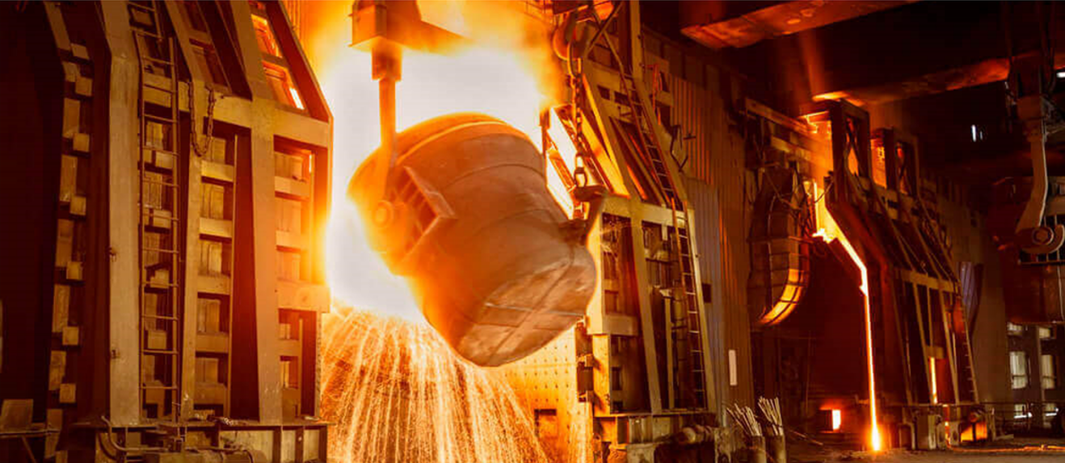
3
Why carbon will remain essential to Carbon Neutral Steelmaking 10/2022
Carl De MARE, Former Vice President, New Technologies Group, ArcelorMittal
​
Steel key figures : total world crude steel production = 1.9 Gt/y
(as per 2020) total global CO₂ emissions = 2.6 Gt/y
primary steelmaking = BF + BOF (coke + carbon) : 70%
EAF (electricity) : 25 %
DRI & EAF (methane & electricity): 5 %
Green hydrogen DRI : requested amount of hydrogen = 115.9 Mt/y
(as reductant) requested electrical power = 800 GW
total CO₂ abatement = from 2,2 Gt/y down to 1.8 Mt/y (2050)
total costs = 2.9-9.9 TEUR
Smart carbon steelmaking : CCS (storage) + CCE (export) + CCU (ethanol C₂H₅OH) + H₂ injection (BF&DRI)
gasification & torrefaction + endless recycling (scraps) as combined solutions

Slide 4
Carbon Neutral Steelmaking – Carl De MARE 3b
Sigles et acronymes
BF : Blast Furnace (Haut Fourneau)
BOF : Basic Oxygen Furnace
CCE : Carbon Capture and Export
CCS : Carbon Capture and Storage
CCU : Carbon Capture and Utilization
DRI : Direct Reduced Iron
EAF : Electric Arc Furnace
Limestone : Calcaire
Pig Iron : Fonte brute
Scrap : Ferraille
SF : Shaft Furnace (countercurrent reactor)
Références
SEII événement 27/10/22 : « Presentation (slides) » Carl De MARE
SEII Library : article « Green Hydrogen for a clean steel industry » Bernard MAIRY

Slide 5

Comment l’industrie du verre et la RW comptent maintenir leur compétitivité respective dans le cadre de la transition énergétique 3/2023 Marc VAN DEN NESTE, former CTO AGC Flat Glass, DG ECOSYS
5
AGC Flat Glass : melting furnaces, floating furnaces, heating furnaces
Conversion to : hydrogen combustion furnaces (instead of CH₄)
electrical furnaces (renewables, low carbon)
hydrogen production (electrolyse, plasmalyse & thermolyse)
e-CH₄ production (renewables, low carbon)
District Cleantech : a new strategic industrial zone (Charleroi) to reduce GHG
Technologies : electricity & hydrogen (renewables), CCU, waste circularity,
urban heating (steam),urban building renovation,urban agriculture

Slide 6
Industrie du verre et Région Wallonne – Marc VAN DEN NESTE 5b
Sigles et acronymes
e-CH4 : Biométhane
floating furnace : Four à flottation
heating furnace : Four à chaleur
melting furnace : Four à fusion
GHG / GES : Greenhouse Gas / Gaz à effet de serre
Références
SEII événement 29/3/23 : « Compétitivité de l’industrie du verre et de la Region Wallonne dans la transition énergétique »

Slide 7
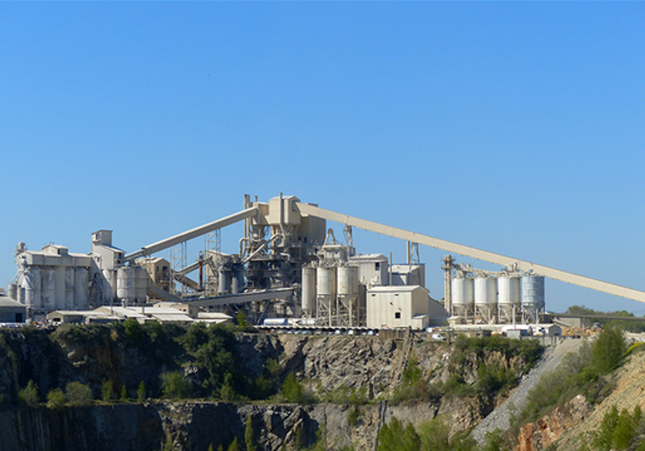
Les secteurs du ciment et de la chaux vers la neutralité carbone: une transformation d’une ampleur exceptionnelle 6/2023
Bernard MATHIEU, ex VP Energy Transition Lafarge & Holcim, ULB Solvay
7
Cement key figures : total world cement production = 4.1 Gt/y (2019) & 4.6 Gt/y (2024)
total world CO₂ emissions = 3.2 Gt/y (2019) & 3.6 Gt/y (2024)
5-8 % global world emissions
70 % due to lime kilns
Targets : total world CO₂ emissions = 2 Gt/y (2030) and 0 Gt/y (2050)
Technologies : CCU + CCS
green hydrogen (as fuel) + oxyfuel
green electricity (renewables, low carbon)
waste + biomass + e-fuels
circularity = 1/3 CO₂ emissions recycled by lime carbonatation in concrete
new cement substitute = calcined clays (instead of traditional clinker)
Investment costs : 1.5-2.0 GEUR (Wallonia)

Slide 8
Secteurs du ciment et de la chaux vers la neutralité Carbone – Bernard MATHIEU 7b
Sigles et acronymes
Calcined clay : argile calcinée
Clinker : constituant du ciment
e-fuel : carburants de synthèse
Lime : chaux
Oxy-combustion : combustion avec oxygène pur (ald d’oxygène de l’air)
Oxyfuel : comburant pour l’oxy-combustion
Références
SEII événement 21/6/23 : « Présentation (slides) » Bernard MATHIEU

Slide 9
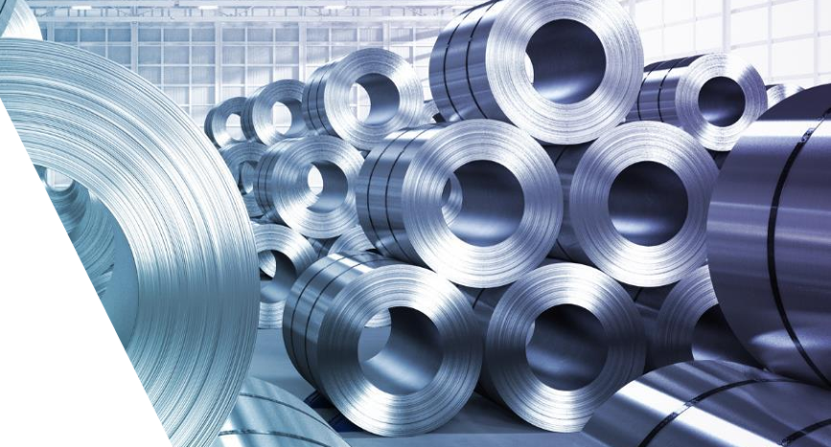
L’aluminium: un levier clé de la transition énergétique 9/2023
Christian LEROY, Director Innovation European Aluminium
9
Aluminium key figures : total EU production = 13 Mt/y (turnover = 40 GEUR), including imported material
total EU GHG emissions = 30 Mt/y (2018) & 3 % global world industry emissions (2021)
by process = alumina (NaOH + hydrolyse) 6 Mt/y + smelting (electrolyse + cryolithe
Na₃AlF₆) 17 Mt/y + semi-fabrication & product manufacturing 5 Mt/y
footprint = 4 kg CO₂ /kg Al (hydro-electricity) and 20 kg CO₂/kg Al (carbon electricity)
Targets : total european GHG emissions = 30 Mt/y (2018) and 0 Mt/y (2050)
Technologies : decarbonized electricity (hydroelectricity & renewables) for above processes
decarbonized electricity (renewables) for bauxite mining
decarbonization of processes: inert anodes (to replace graphite, zero CO₂, O₂ production)
electric furnaces (intead of gas-fired), furnaces with low carbon fuels, hydrogen, oxyfuel
maximizing circularity via smarter recycling routes = 90% Al recycled in EU (0.5 kg CO₂ /kg Al )
Aluminium : key enabler for energy transition = light + recyclable for EV, PV, packaging, building, electronics

Slide 10
L’ Aluminium, un levier-clé de la transition énergétique – Christian LEROY 9b
Sigles et acronymes
Alumina : Oxyde d’aluminium hydraté
(Le plus abondant dans la croute terrestre après le silicium)
Bauxite : Minerai mélange d’hydroxydes d’aluminium, d’oxydes de fer et de silice
Cryolithe : Fluorure double d'aluminium et de sodium (Na₃AlF₆)
Obtenu comme Minerai au Groenland ou par Synthèse
Références
SEII événement 27/9/23 : « Présentation (slides) » Christian LEROY

Slide 11
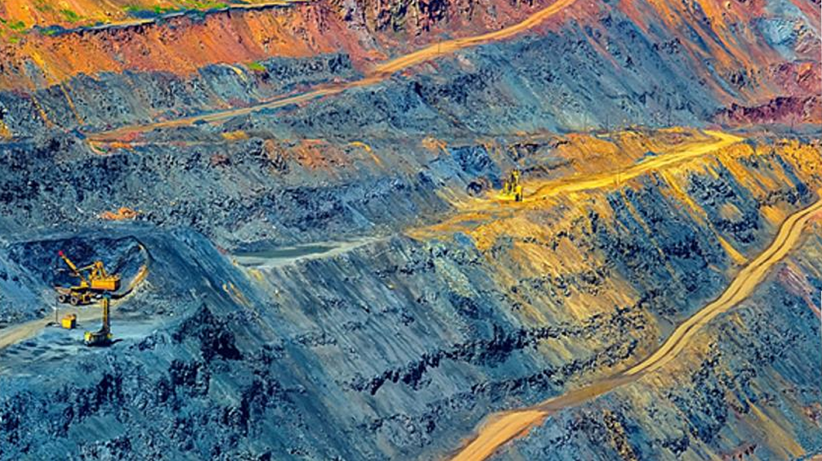
Le grand LEGO des éléments : comment rendre réels nos rêves technologiques ? 11/2023 Léopold DEMIDDELEER , ex VP R&D Solvay, expert materials chemistry
11
REE rare earth elements and CM critical materials :
REE : 15 Lanthanides (all valence 3) : La , Ce (4) , Pr , Nd , Sm , Eu , Gd , Tb , Dy , Ho , Er , Tm , Yb , Lu , + Y + Sc
CM : Sb , Be, Co , F , Ga , In , Mg , Pt , Ta , Nb, W , Graphite
Key enablers for energy transition: PV (solar), magnets (wind, EV), batteries (EV, data centers), screen/casing (phones)
Footprint : serious impacts due to very complex chemical/metallurgical processes for element separation like
acid extraction, liquid/liquid extraction, ion exchange resin, electrolyse + ethical issues (Coltan Ta-Nb)
How to solve such a paradox? to develop new clean extraction processes (chemical and metallurgical)
to assess and optimize life cycle analysis (including recycling of RRE and CM)
to change application to reduce REE & CM content and use alternative solutions
to develop a fair and ethical exploration & mining of REE and CM
Note : nuclear elements like U, Pu, Th not considered in this summary

Slide 12
Le grand LEGO des éléments– Léopold DEMIDDELEER
Sigles et acronymes
CM : Critical Materials
EV : Electric Vehicles
PV : Photo Voltaïque
REE/ETR : Rare Earth Elements / Eléments Terres Rares
Références
SEII événement 24/11/23 :
« Presentation (slides) » Léopold DEMIDDELEER
« Article de synthèse » Léopold DEMIDDELEER

Slide 13
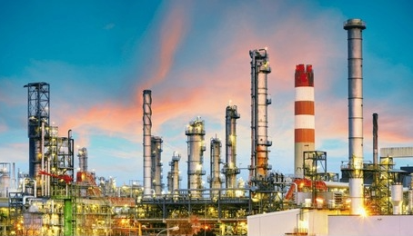
Le monde pétrolier et la transition énergétique 12/2023 Xavier LIMPENS & Michel GOVAERTS , ex TotalEnergies
13
Oil and Gas key figures : total world oil production = 100 Mb/d (M barrels per day)
total oil reserves = 10,420 EJ (Exajoule) (IA + BP Statistics)
total world gas production = 4,000 Bcm (Gm³)
total gas reserves = 7,920 EJ (Exajoule)
(IA & BP statistics 2022-2024)
Perimeter : exploration, production, transportation, oil refinery, petrochemistry (to some extent)
GHG emissions : world energy-related GHG = 41 Gt CO₂-eq/y (2022)
world GHG from oil operations (from exploration to refinery) = 3.5 Gt CO₂-eq/y
world GHG from gas operations (from exploration to ex-works delivery) =1.6 Gt CO₂-eq/y
Target : 0 Gt/y (2050)
Technologies : CCS = CO₂ sequestration in saline aquifers and depleted fields (up to 10 Gt CO₂/y for all sectors)
reorientation of exploration towards lighter oil fields and gas fields
development of low emission marine transportation
conversion to renewables : electricity and hydrogen (Exajoule = 277.8 TWh)

Slide 14
Le monde pétrolier et la transition énergétique – Xavier LIMPENS & Michel GOVAERTS
Sigles et acronymes
Unités d’énergie : J (Joules) (1J = 277,8.10⁻⁶ Wh); Wh (Watt.heure) (1 Wh = 3600 J)
1 EJ (ExaJoule) = 10¹⁸ J = 277,8 TWh
Unités de volume :
OIL : b = barrel; 1Mb = 10⁶ b ; production = 100 Mb/day
Contenu énergétique des réserves = 10,42 EJ
GAS : BCM = Billion Cubic Meter (1 BCM = 10⁹ m³) ; production = 4000 BCM/day
Contenu énergétique des réserves = 7,920 EJ
CO₂-eq : équivalent CO₂
IA = I(E)A = International Energy Agency
BP : British Petroleum
Références
SEII événement 15/12/23 : « Article résumé » Xavier LIMPENS & Michel GOVAERTS

Slide 15
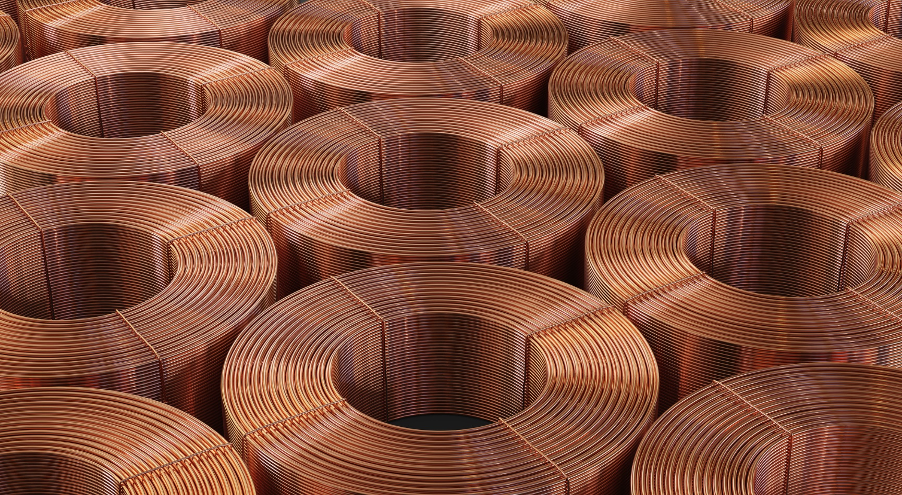
Le Cuivre: matériau stratégique pour l’Europe et la transition énergétique Quentin de HULTS, DG International Copper Association ICA Europe 11/2024
15
Copper key figures : total world copper production = 22 Mt/y (2023)
carbon intensity = 4,6 tCO₂ eq/t Cu (ICA 2018)
total GHG emissions = 0,2 % of total global emissions
processes = mining, concentration, smelting (fusion), electrolyse (refinery), casting and rolling
copper is a strategic metal , not a critical raw material
expected demand growth = 35 % in EU and 100 % global by 2050
Targets : towards Net Zero for Scope 1 & Scope 2 by 2050 (step-by-step targets by 2030 and 2040)
Technologies : low-carbon electricity (renewables) for copper mining and above processes
shifting copper ore concentration directlty on mines (flottation & leaching from 1-2 % Cu to 30 % Cu)
injecting hydrogen (renewables, low carbon) in natural gas-fired furnaces
maximizing circularity (up to 80 % recovery from electronics waste)
Copper : key enabler for energy transition = electricity infrastructure, building, transportation, electronics, IT and
electrification of uses

Slide 16
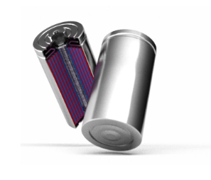

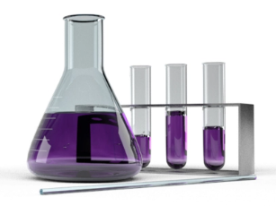
UMICORE’s approach to manufacture low carbon footprint metals and products 12/2024 Wouter GHYOOT , VP Government Affairs UMICORE
16
Key figures : sectors = battery materials, catalysis, recycling and specialty materials (all non-ferrous field)
products = 18 elements : Ag, Au, Pt, Pd, Rh, Ir, Ru / In, Te, Se, Sb, Sn, Bi / Pb, Cu, Ni, Co, Mn / H₂SO₄
footprint in 2023= -1.4 Mt GHG/y (recycling) & -2.4 Mt NO_{x}/y (catalysis) & - 7.3 Mt GHG/y (batteries
+ specialty materials) total = -11.1 Mt/y avoided in 2023
scopes 1 = direct emissions, 2 = indirect emissions (purchased energy), 3 = other indirect emissions
Targets : total GHG emissions Scope 1 + Scope 2 = - 50 % Mt/y vs 2019 (2030) and 0 Mt/y (2035)
total GHG emissions Scope 3 = - 45 % Mt/y vs 2019 (2030)
Technologies : low-carbon electricity (renewables)
no more mining activities
energy efficiency & heat efficiency
process innovation in pyro-metallurgy and hydro-metallurgy
CCS and CCU
Non-ferrous materials : key enabler for energy transition = EV, PV, wind mills, electronics, harmful emissions

Slide 17
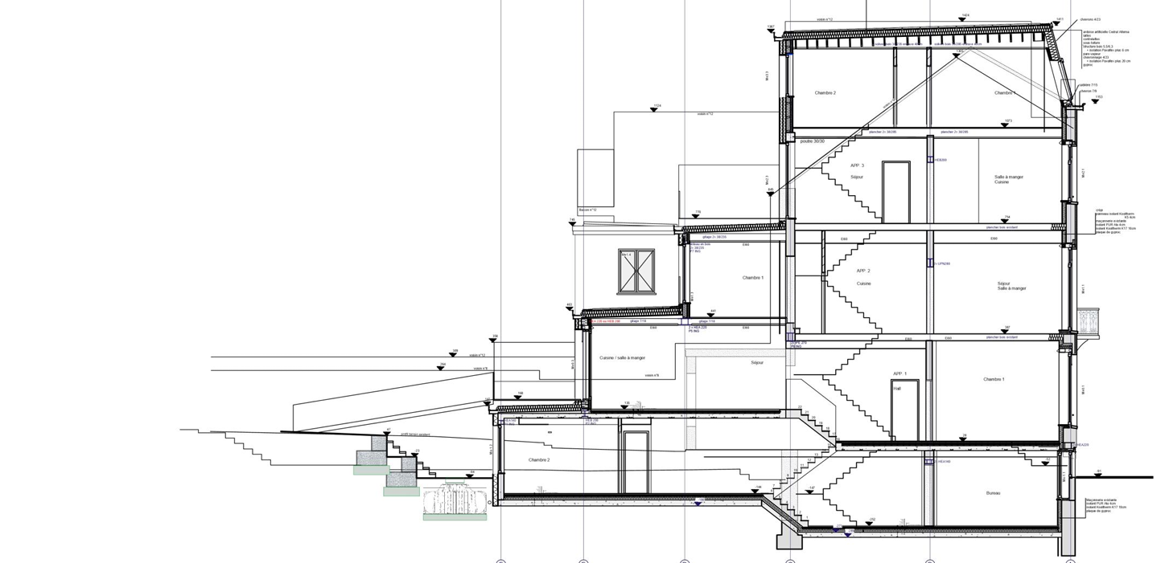
Les défis de la transition énergétique pour les secteurs de la construction et de l’immobilier 01/2025
Erwin SPITZER & Savina VAN DE PUT, ARIB Architects in Brussels
17
Key figures : GHG emissions for building construction & operation in EU : 36 %
GHG emissions for building construction & operation in Brussels : 65 %
(36 % tertiary & 64 % residential)
Brussels targets : no more new oil-fired boilers and new gas-fired boilers by 2025
no more housing with F & G ranking by 2033 : <275 KWh/m².year
no more housing with D & E ranking by 2045 : <150 KWh/m².year
mean housing consumption by 2050 : 100 KWh/m².year
Technologies : insulation of roof, walls & windows
optimization of heating and air-conditioning systems
protection against overheating due to lower inertia and thermal insulation
electrification of uses (renewables)

Slide 18
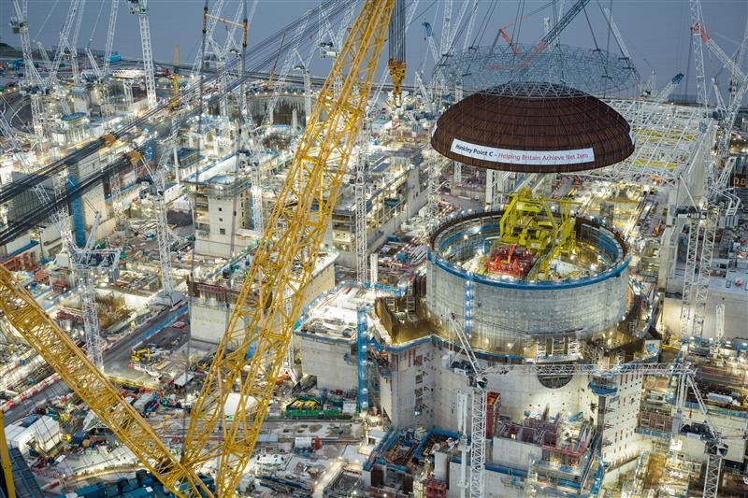
Regards de l’engineering sur les défis de la transition énergétique 2/2025 Anicet TOURE , Tractebel-Engie Strategy & Innovation Manager
18
Tractebel-Engie expertises : hydro-plants, wind parks, nuclear & gas power plants, electricity T+D, ports+marine infrastructure
Keynote message : « Nuclear power helps to reduce the industry’s carbon footprint »
Vision : energy mix objectives & timeframe for Belgium (power & consumption)
2037 : 1.2 GW Gen II (SMR large scale)
2040 : start of Gen IV deployment
2050 : 4-8 GW of new nuclear (new large reactors & SMR’s)
2025 : 85 TWh (ELIA)
2035 : ENRI 100-150 TWh
2050 : Hydrogen 125-200 TWh
Technologies : SMR’s as cornerstones of tomorrow’ energy ecosystems
Industrial heat : LWR (<250°C) , MSR (<550 ° C),LFR (<500°C) , VHTG (<1,000°C)
Urban/District heating
Pink hydrogen
Data centers
Marine transportation (micro SMR’s)
Seawater desalination (water stress)

Slide 19
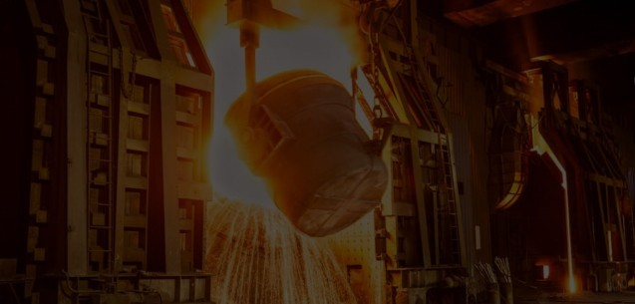

Chimie & Sciences de la Vie en Belgique: une industrie en transition 4/2025 Yves VERSCHUEREN , CEO ESSENSCIA , Fédération des secteurs de la Chimie et des Sciences de la vie
19
ESSENSCIA key figures : sectors = chemicals, plastics and pharmaceuticals
100,000 employees ; 1/3 total Belgian exports ; 6.3 G€ investment in 2023 (18 % in R&D)
Antwerpen main stakeholders = BASF, Solvay, Ineos, Fluxys, TotalEnergies, ExxonMobil,
AirLiquide
biggest underground gas pipeline worldwide (25 % for all chemicals transportation)
Target : 70 % foot print reduction by 2040 ( instead of 95% requested by Clean Deal)
Technologies : low-carbon electricity (renewables, nuclear)
low carbon energy supply
green heat & green hydrogen as feedstock and energy carrier
energy/heat efficiency = + 75% (since 1995) ; shutdown of vaporcracking (TotalEnergies)
CCS /CCU = liquefaction and offshore storage North Sea (BASF & ArcelorMittal)
chemical recycling of plastics
process innovation = BlueChem biggest incubation R&D Center in EU
Other solution : increase of ETS value (from 100 to 200-250€/t CO₂) for fair competitiveness purposes

Slide 20
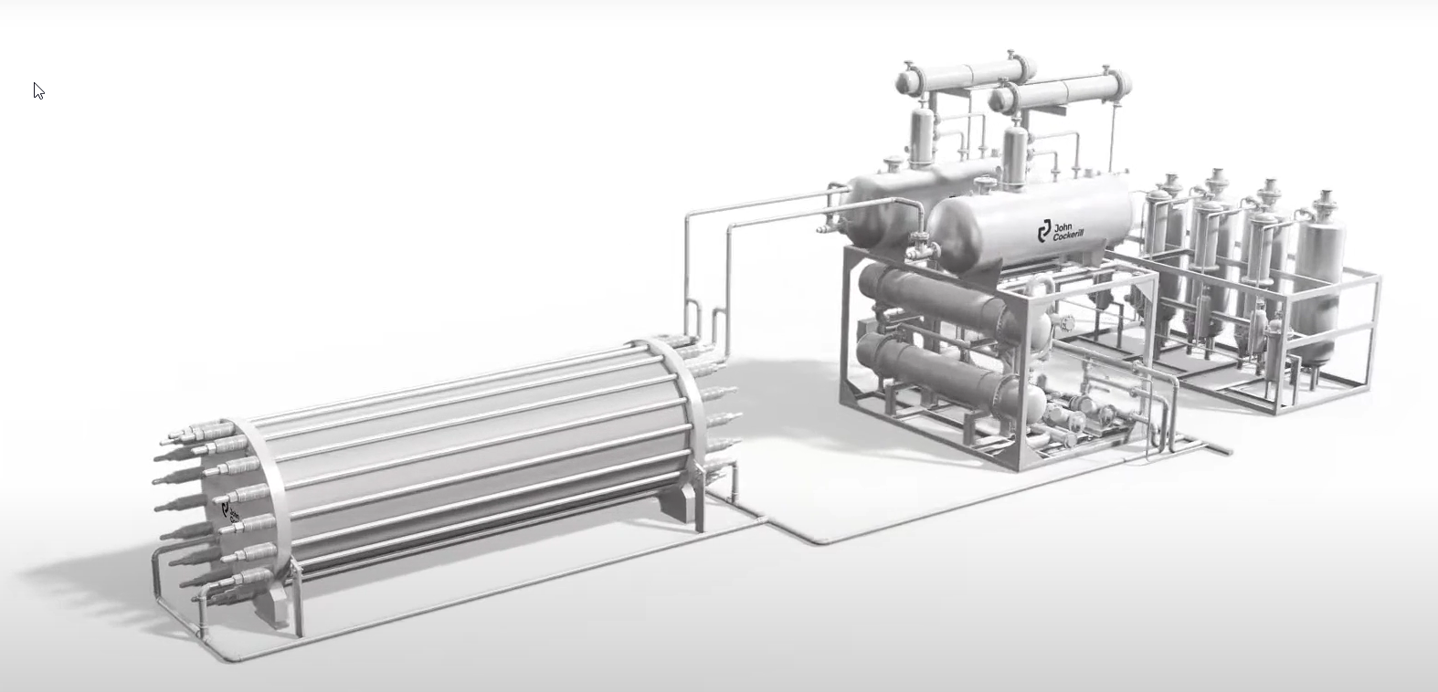
Quel rôle de l’hydrogène dans la transition énergétique, en particulier pour la décarbonation ?
Mirage ou réalité ? 10/2025
Raphaël TILOT , CEO John Cockerill Hydrogen
20
Hydrogen : as energy vector and as reductant to decarbonize « hard-to-abate » industries
hydrogen production by electrolysis of water
integration of electrolysers with electricity from renewable sources and nuclear plants
available as molecule (H₂) and as e-molecules (ammonia CH₃ and methanol CH₃OH)
Priority applications : feedstock for industrial processes : fertilizers , refinery and steel
feedstock for transport : road and maritime
feedstock for other specific applications
Hydrogen : a possible enabler for energy transition ?

Slide 21

Tentative summary and conclusions
21
Targets:
All reviewed sectors claim they target « Net Zero Emission by 2050 »…however, not all are on the same track : most are starting , some are somewhere and a very few may/will approach or reach the target
(UMICORE 0% scopes 1 + 2 by 2035 & ESSENSCIA 70 % foot print reduction by 2040)
It looks « hard-to-believe » they will get to Net Zero Emission as all sectors look « hard-to-abate », some processes may even not be « able-to-abate »
Solutions:
Potential solutions : CCS, CCU, innovative processes, but not all are presently mature or obvious to be implemented
An « obvious » solution is to use low-carbon electricity: like for metallurgy (EAF), machinery, transport
Financing :
Decarbonization will require significant/huge investments which are not affordable for most sectors
Therefore subsidies and access to public or private financing (long term) would be mandatory
Timing and final target:
Timing presently looks much too short and not realistic, so as the decarbonization agenda should be seriously postponed and spread as well as the final target should be revised and weighed !
CO₂ emissions in worldwide perspective : 0,2% Belgium including 0,08% for industry

Slide 22
Défis de la transition énergétique et de la décarbonation pour l’industrie.
22
Merci pour votre attention.

Slide 23
Decarbonization of the steel industry : recent cost estimates from the main plant builder Peter KINZEL & Jihong JI , SMS-Group , Mönchengladbach (01/2025)
23
Assuming a 2.5 Gt/y green steel plant requiring a 2 GW power plant :
1. Total energy supply investment : > 10 G USD
Renewable electricity production = 5 G USD
Hydrogen production = 4 G USD
Energy storage > 1 G USD
2. Total greenfield DRI steel plant : = 3 G USD
Direct reduction iron plant = 1 G USD
Steelmaking EAF plant = 0.5 G USD
Downstream plant (rolling mills) = 0.5 G USD
Balance of plant = 1 G USD
Total SMS-Group estimate of > 13 G USD "fits rather well" with the rough estimate of 2.9-9.9 G USD for the decarbonization of 1,300 Gt (BF/BOF road) world capacity: 1,300/2.5x13= 6.8 G USD (ref:BMY SEII)
Other limitations: high grade iron ores availability and engineering/building capacity

Slide 24
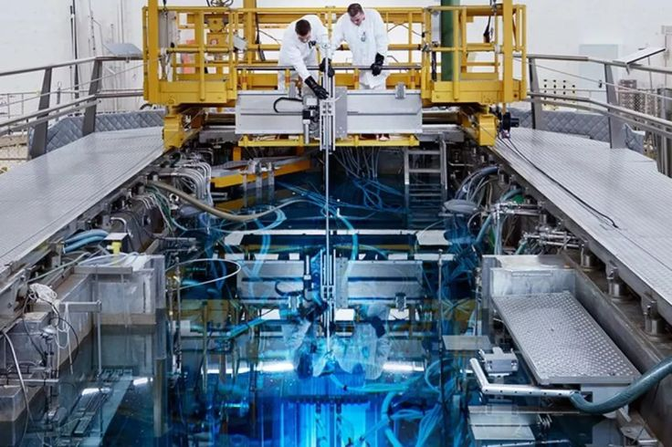
Le Thorium, un élément clé dans le futur ? 1/2024 Michèle HUART et Francesca CAROBENE , SOLVAY Thorium
24

